Slide 1

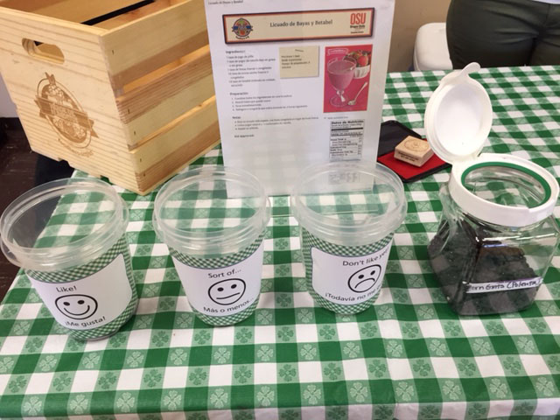
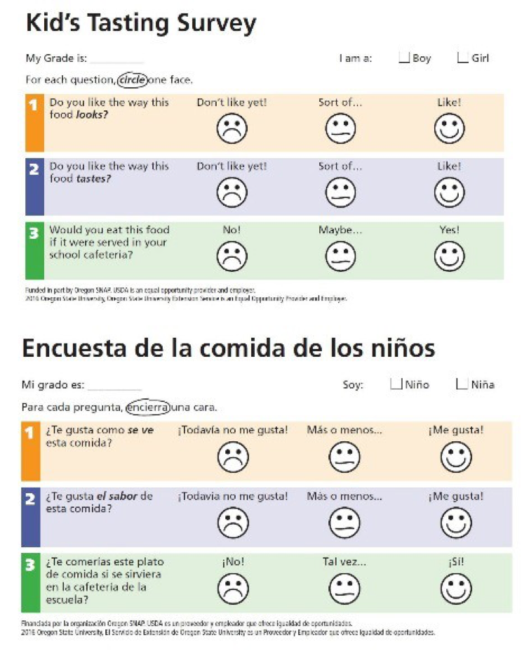
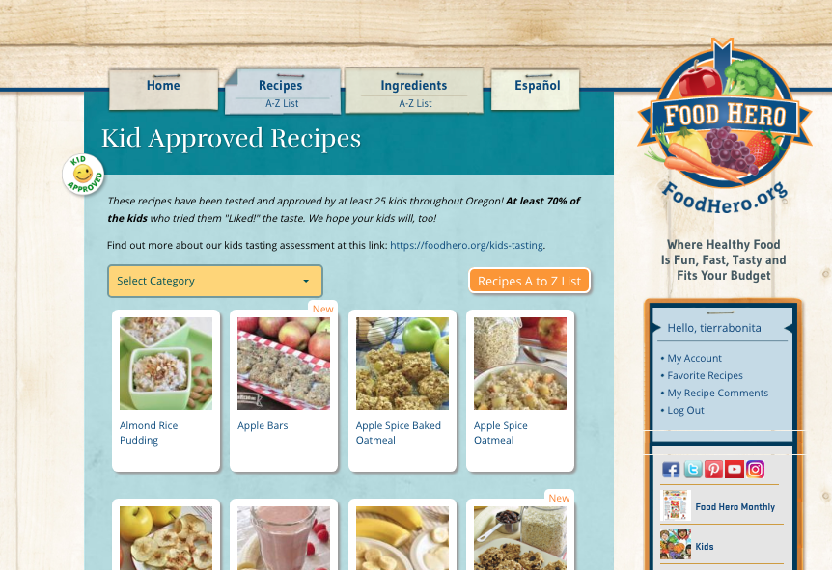



Oregon State University Extension Service Family and Community Health SNAP-Ed Program, College of Public Health and Human Sciences
Promoting Healthy Growth and Healthy Eating Choices Among Children and Families
in Oregon with the Food Hero Social Marketing Campaign
Paid for in part by Oregon SNAP.
Lauren Tobey, MS, RD; Maureen Quinn; Joyce Senior Angulo, PhD; Elaine Schrumpf, MS. College of Public Health and Human Sciences; Extension Family and Community Health, Oregon State University
Background
Food Hero is a social marketing campaign aimed at increasing fruit and vegetable (FV) consumption and reducing the prevalence of obesity among low-income Oregon families. The campaign offers both education and policy, systems and environmental-change activities guided in part by the social cognitive theory.
A major component of the campaign is its ongoing recipe project. To encourage healthy behaviors at home and at school, recipes are promoted with mothers as well as at school and childcare foodservice sites. Of the more than 300 Food Hero recipes available on our site, more than 70 have been quantified into 4 yields and analyzed by Child Nutrition Specialists to meet the USDA meal pattern requirements for schools and child centers.
Methods
A Spanish/English Kids Tasting Survey and accompanying disc voting process were created in 2015 to be used in community/school sites where ≥ 50% children qualify for free/reduced meals. This assessment has three objectives: 1) Identify recipes most liked by kids; 2) Encourage respondents to promote FH; 3) Share results to promote recipe use at the family, school and community levels. When 70% or more of the children “Liked!” the taste and at least 25 children were assessed, a recipe was tagged “Kid Approved.”
Disc voting method
The Food Hero website (www.foodhero.org) houses our ”Kid Approved” recipes
Results From March 2015-2018
  62,459 assessments were completed on 190 recipes.
  Of the respondents, 40% were from the paper survey and 60% the disc voting.
  55 Food Hero recipes were ”Kid Approved.”
  25 Food Hero Quantity Recipes were “Kid Approved.”
Conclusions and Implications
Kids Tasting assessment results have proven to be empowering to children. They also help us identify popular recipes to suggest for foodservice menus and to promote at community events.
This research supports continued use of the Kids Tasting Assessment, which has been successful in promoting the Food Hero social marketing campaign and increasing F&V consumption at the family, school and community levels in Oregon.
Contact Us:
Food.Hero@oregonstate.edu

